Slide 1
CPTP Monthly Training Coordinator Support Call
August 6, 2024

Slide 2
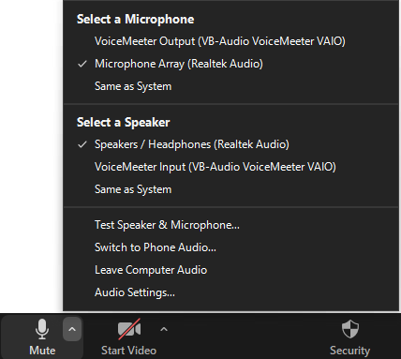
Housekeeping
All lines are muted at this time.
If you can’t hear us, this is probably why!
You can switch to phone audio here.

Slide 3
User Call Tips
If you have a question/comment
Raise your hand and I’ll unmute you
Type it in the Q & A box
I will monitor and answer them as they come in

Slide 4
ILT Updates
New Facilitation Manager – Christee Atwood
September schedule is in SuccessFactors
October schedule will be in SuccessFactors by the end of next week
Please encourage your people to use the request course feature in SuccessFactors for the courses they need – informs our scheduling
Plenty of opportunities for Core and G1 Capstones
Notes:
https://civilservice.louisiana.gov/files/Divisions/Training/2024%20Calendar.pdf

Slide 5
ILT Updates
Newly revised courses
Developing Effective Teams (Formerly Teams 3)
Professional Writing
Professionalism in the Workplace
Notes:
https://civilservice.louisiana.gov/files/Divisions/Training/2024%20Calendar.pdf

Slide 6
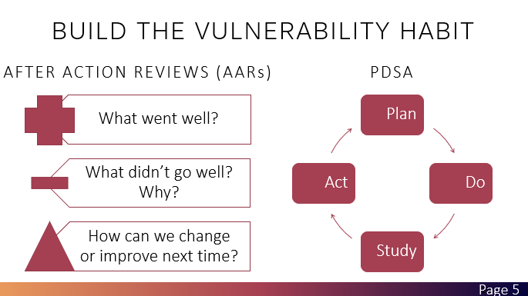
Developing Effective Teams
Upon completion of this course, you will be able to:
Explain the characteristics of an effective team
Demonstrate behaviors that build team culture
Apply strategies to overcome team challenges

Slide 7
Professional Writing
Upon completion of this course, you will be able to:
Write clear, concise, and action-oriented communication
Adjust language, style, and level of communication to fit the purpose and audience
Maintain a professional and confident tone in your written communication
Use resources to help you identify and correct grammar usage problems

Slide 8
Professional Writing

Slide 9
Professionalism in the Workplace
Upon completion of this course, you will be able to:
Describe standards of success for Louisiana’s State 9 competencies for professionals
Examine the impact of professionalism on individual career advancements and organizational success
Incorporate strategies for developing professionalism in personal and professional interactions

Slide 10
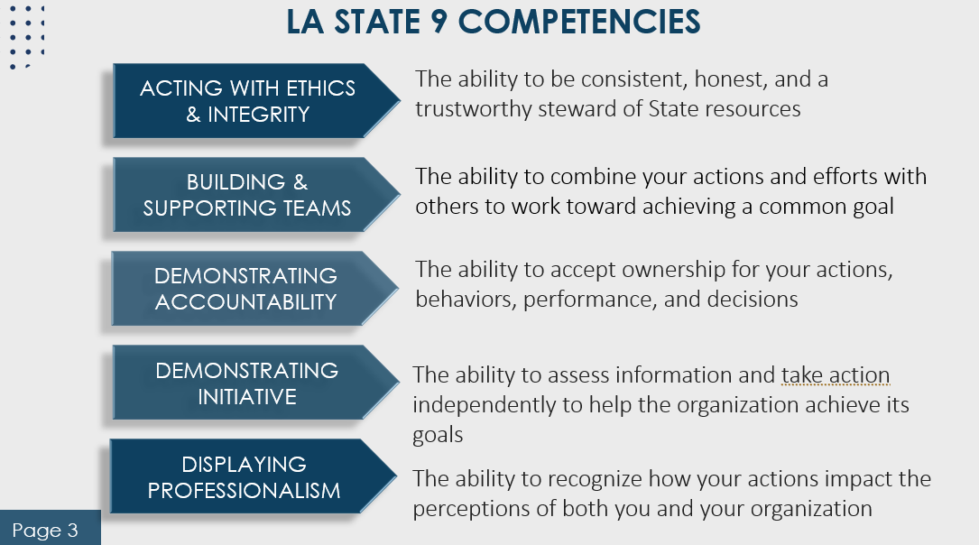
Professionalism in the Workplace

Slide 11
General Updates
REMINDER: Maintenance in SF will occur in the coming months
Planning on cleaning up assignment profiles
Be patient, you might see people reassigned to MTR’s – please ignore it
TC updates
Please let us know if you are leaving your role as TC and provide us with your replacement’s information

Slide 12
General Updates
Continuing Education
Deadline for current list extended through the end of the year
Will correspond with the new performance year starting in January 2025
Moving to a calendar year instead of a fiscal year

Slide 13
Report Round-up
Program Status Report CSV
Useful for supervisor MTR training status
Shows you the percentage complete
Can select individual activities to see what specific class or classes that they’re missing

Slide 14
Report Round-up
We want to hear from you!!!!
What reports are you interested in?
What reports are helpful for you?
LET US KNOW!!

Slide 15
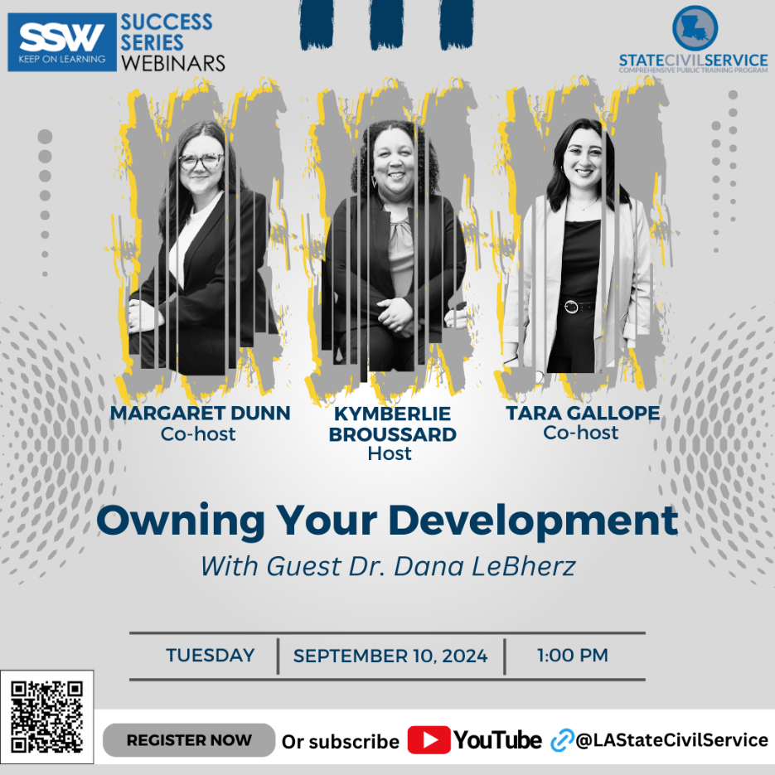
Success Series Webinars

Slide 16
TC Mailbag
“What are the mandatory training requirements for supervisors?”
Anonymous
Check the CPTP website for FAQ’s!

Slide 17
Questions
Contact CPTP if you have any questions:
_SCS-CPTP@la.gov
Glyn.Hays@la.gov
Julie.Miller4@la.gov
Tanyeka.Green@la.gov
(225) 342-8539

